Slide 2
Procedure:
1-Weigh 4 gm of NaOH and dissolve it in one liter distilled water.
2- Transfer 10 ml of standard HCl solution to a conical flask.
3- Add 1-2 drops of phenolphthalein (ph.ph) as an indicator.
4- Fill the burette with the prepared NaOH solution.
5- Add NaOH drop by drop into the conical flask until the color of the solution is faint pink.
6- The exact normality of NaOH is obtained from:
HCl + NaOH NaCl + H₂O
N₁V_{1(NaOH)} = N₂V_{2(HCl)}

Slide 4
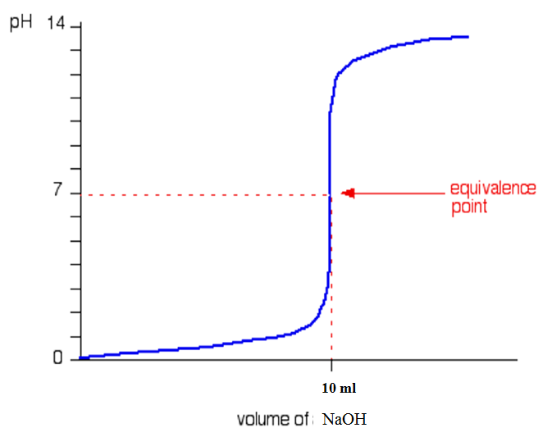
Titration curve:
This is very similar to the previous curve except, of course, that the pH starts off low and increases as you add more sodium hydroxide solution.
Again, the pH doesn't change very much until you get close to the equivalence point. Then it surges upwards very steeply.

Slide 5
Homework:
Why is a indicator such as phenolphthalein used in neutralizing reactions between a strong Acid and a strong Base ?
Write the mechanism of action of the phenolphthalein indicator in neutralizing reactions between a strong acid and a strong base.
Explain in detail the neutralization curve between the reaction of a strong acid and a strong base?
Lecturer
H. N. K. AL-Salman

